Slide 1

“Logistics Optimization for Delivery Routes – FedEx”
SQL-based Analytics & Optimization
Presented By “Saumya Jain”

Slide 2

Project Objective & Scope
Analyze FedEx delivery performance using SQL
Clean and prepare shipment, route, warehouse, and agent data
Identify delays by route, warehouse, and agent
Build KPIs to measure efficiency and on-time delivery

Slide 3
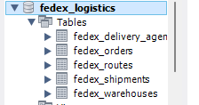
Data & Schema Overview Video Link: https://reccloud.com/u/ylzwasb
Add List of Tables
• Fedex_Orders
• Fedex_Shipments-
• Fedex_Routes
• Fedex_Warehouses
• Fedex_Delivery_Agents
Steps Follow
Go to My SQL Workbench
Right Click and create schema Name Fedex Logistic
Import all the database into click table data import Wizard

Slide 4

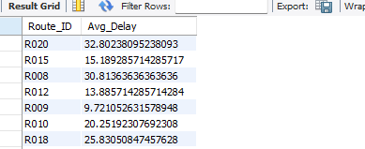

Task 1: Data Cleaning & Preparation
Point 1 Query Used:
USE fedex_logistics;SELECT *FROM fedex_orders;SELECT Order_ID, COUNT(*) AS cntFROM fedex_ordersGROUP BY Order_IDHAVING COUNT(*) > 1;
Select * from fedex_shipmentsSELECT Shipment_ID, COUNT(*) AS cntFROM fedex_shipmentsGROUP BY Shipment_IDHAVING COUNT(*) > 1;
Point 2 Query Used: NULL Delay_Hours
SELECT COUNT(*) AS Null_DelaysFROM fedex_shipmentsWHERE Delay_Hours IS NULL;
Average delay per Route_ID
SELECT Route_ID, AVG(Delay_Hours) AS Avg_DelayFROM fedex_shipmentsWHERE Delay_Hours IS NOT NULLGROUP BY Route_ID;
Point 3 Query Used:
SELECT *FROM fedex_orders;ALTER TABLE fedex_ordersADD COLUMN Order_DateOnly DATE,ADD COLUMN Order_TimeOnly TIME;UPDATE fedex_ordersSET Order_DateOnly = DATE(Order_Date), Order_TimeOnly = DATE_FORMAT(Order_Date, '%H:%i:%s’);
Select * from fedex_shipmentsALTER TABLE fedex_shipmentsADD COLUMN Pickup_DateOnly DATE,ADD COLUMN Pickup_TimeOnly TIME,ADD COLUMN Delivery_DateOnly DATE,ADD COLUMN Delivery_TimeOnly TIME;UPDATE fedex_shipmentsSET Pickup_DateOnly = DATE(Pickup_Date), Pickup_TimeOnly = DATE_FORMAT(Pickup_Date, '%H:%i:%s'), Delivery_DateOnly = DATE(Delivery_Date), Delivery_TimeOnly = DATE_FORMAT(Delivery_Date, '%H:%i:%s');

Slide 5
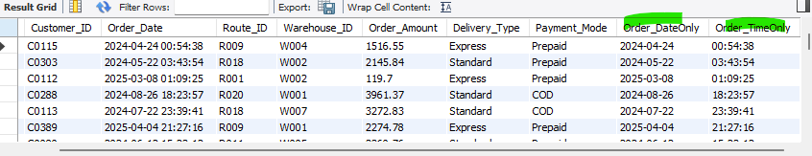
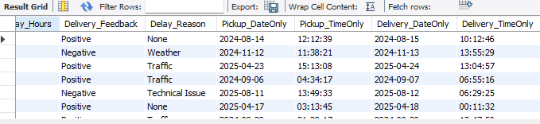
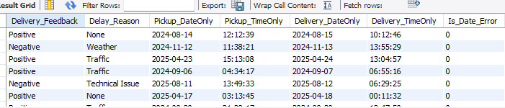
Task 1: Data Cleaning & Preparation
Point 3:
Point 4 Query Used:
Select * from fedex_shipmentsALTER TABLE fedex_shipmentsADD COLUMN Is_Date_Error TINYINT(1) DEFAULT 0;
UPDATE fedex_shipmentsSET Is_Date_Error = 1WHERE Delivery_Date < Pickup_Date;
SELECT Shipment_ID, Pickup_Date, Delivery_DateFROM fedex_shipmentsWHERE Delivery_Date < Pickup_Date;

Slide 6


Task 1: Data Cleaning & Preparation
Point 5 Query Used: Referential Relationship
1. Orders missing Route_ID
SELECT o.Order_ID, o.Route_IDFROM fedex_orders oLEFT JOIN fedex_routes r ON o.Route_ID = r.Route_IDWHERE r.Route_ID IS NULL;
Find orders whose Route_ID does not exist in fedex_routes table
2. Orders missing Warehouse_ID
SELECT o.Order_ID, o.Warehouse_IDFROM fedex_orders oLEFT JOIN fedex_warehouses w ON o.Warehouse_ID = w.Warehouse_IDWHERE w.Warehouse_ID IS NULL;
Find orders assigned to a warehouse that doesn’t exist.

Slide 7


Task 1: Data Cleaning & Preparation
3. Shipments missing Order_ID
SELECT s.Shipment_ID, s.Order_IDFROM fedex_shipments sLEFT JOIN fedex_orders o ON s.Order_ID = o.Order_IDWHERE o.Order_ID IS NULL;
Shows shipments that reference non-existent orders
4. Shipments missing Route_ID
SELECT s.Shipment_ID, s.Order_IDFROM fedex_shipments sLEFT JOIN fedex_orders o ON s.Order_ID = o.Order_IDWHERE o.Order_ID IS NULL;
Find shipments assigned to agents not in the agents table
5. Shipments missing Warehouse_ID
SELECT s.Shipment_ID, s.Warehouse_IDFROM fedex_shipments sLEFT JOIN fedex_warehouses w ON s.Warehouse_ID = w.Warehouse_IDWHERE w.Warehouse_ID IS NULL;

Slide 8

Task 1: Data Cleaning & Preparation
6. Shipments missing Agent_ID
SELECT s.Shipment_ID, s.Agent_IDFROM fedex_shipments sLEFT JOIN fedex_delivery_agents a ON s.Agent_ID = a.Agent_IDWHERE a.Agent_ID IS NULL;

Slide 9

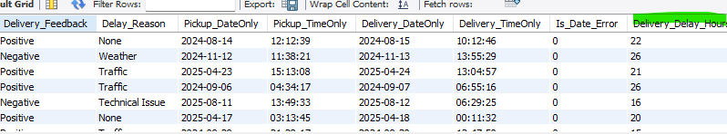
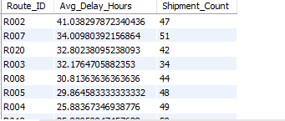
Task 2: Delivery Delay Analysis
Point 2 Query Used:
Top 10 delayed routes (based on average delay hours)
SELECT Route_ID,AVG(Delay_Hours) AS Avg_Delay_Hours,COUNT(*) AS Shipment_CountFROM fedex_shipmentsGROUP BY Route_IDORDER BY Avg_Delay_Hours DESCLIMIT 10;
Point 1 Query Used:
Calculate delivery delay (in hours) for each shipment
Select * from fedex_shipmentsALTER TABLE fedex_shipmentsADD COLUMN Delivery_Delay_Hours INT;UPDATE fedex_shipmentsSET Delivery_Delay_Hours = TIMESTAMPDIFF(HOUR, Pickup_Date, Delivery_Date);

Slide 10
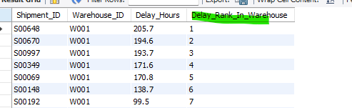
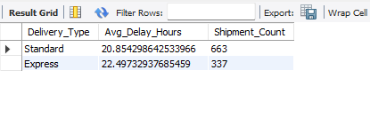
Task 2: Delivery Delay Analysis
Point 3 Query Used:
Select * from fedex_shipments#Rank shipments by delay within each Warehouse_IDSELECT Shipment_ID,Warehouse_ID,Delay_Hours,RANK() OVER (PARTITION BY Warehouse_ID ORDER BY Delay_Hours DESC) AS Delay_Rank_In_WarehouseFROM fedex_shipments;
Point 4 Query Used:
SELECT o.Delivery_Type,AVG(s.Delay_Hours) AS Avg_Delay_Hours,COUNT(*) AS Shipment_CountFROM fedex_shipments sJOIN fedex_orders o ON s.Order_ID = o.Order_IDGROUP BY o.Delivery_Type;
Average delay per Delivery_Type (Express / Standard)

Slide 11
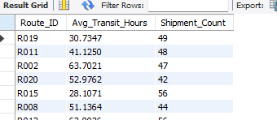
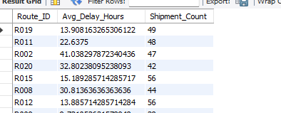
Task 3: Route Optimization Insights
Point 1 Query Used:
Average transit time (in hours) across all shipments per route:
SELECT Route_ID,AVG(TIMESTAMPDIFF(HOUR, Pickup_Date, Delivery_Date)) AS Avg_Transit_Hours,COUNT(*) AS Shipment_CountFROM fedex_shipmentsGROUP BY Route_ID;
Point 2 Query Used:
Average delay (in hours) per route:
SELECT Route_ID,AVG(Delay_Hours) AS Avg_Delay_Hours,COUNT(*) AS Shipment_CountFROM fedex_shipmentsGROUP BY Route_ID;

Slide 12
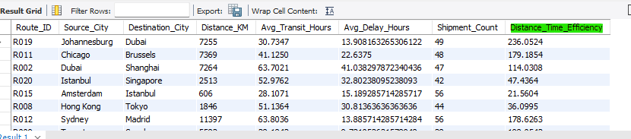
Task 3: Route Optimization Insights
Point 3 Query Used:
Distance-to-time efficiency ratio = Distance_KM / Avg_Transit_Time_Hours
Select * from fedex_shipments
WITH route_stats AS (SELECT Route_ID,AVG(TIMESTAMPDIFF(HOUR, Pickup_Date, Delivery_Date)) AS Avg_Transit_Hours,AVG(Delay_Hours) AS Avg_Delay_Hours,COUNT(*) AS Shipment_CountFROM fedex_shipmentsGROUP BY Route_ID)
SELECT r.Route_ID,r.Source_City,r.Destination_City,r.Distance_KM,rs.Avg_Transit_Hours,rs.Avg_Delay_Hours,rs.Shipment_Count,r.Distance_KM / NULLIF(rs.Avg_Transit_Hours, 0) AS Distance_Time_EfficiencyFROM fedex_routes rJOIN route_stats rs ON r.Route_ID = rs.Route_ID;

Slide 13
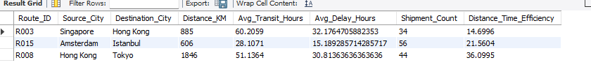
Task 3: Route Optimization Insights
Point 4 Query Used:
Identify 3 routes with the worst efficiency
WITH route_stats AS (SELECT Route_ID,AVG(TIMESTAMPDIFF(HOUR, Pickup_Date, Delivery_Date)) AS Avg_Transit_Hours,AVG(Delay_Hours) AS Avg_Delay_Hours,COUNT(*) AS Shipment_CountFROM fedex_shipmentsGROUP BY Route_ID),
route_efficiency AS (SELECT r.Route_ID,r.Source_City,r.Destination_City,r.Distance_KM,rs.Avg_Transit_Hours,rs.Avg_Delay_Hours,rs.Shipment_Count,r.Distance_KM / NULLIF(rs.Avg_Transit_Hours, 0) AS Distance_Time_EfficiencyFROM fedex_routes rJOIN route_stats rsON r.Route_ID = rs.Route_ID)
SELECT Route_ID,Source_City,Destination_City,Distance_KM,Avg_Transit_Hours,Avg_Delay_Hours,Shipment_Count,Distance_Time_EfficiencyFROM route_efficiencyORDER BY Distance_Time_Efficiency ASC -- worst (slowest) firstLIMIT 3;

Slide 14
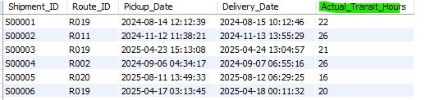
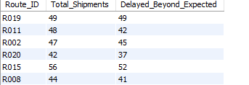
Task 3: Route Optimization Insights
Point 5 Query Used:
Compute Actual Transit Hours for each shipment
SELECT Shipment_ID,Route_ID,Pickup_Date,Delivery_Date,TIMESTAMPDIFF(HOUR, Pickup_Date, Delivery_Date) AS Actual_Transit_HoursFROM fedex_shipments;
2.Count shipments delayed beyond expected per route=fedex_routes.Avg_Transit_Time_Hours
SELECT s.Route_ID,COUNT(*) AS Total_Shipments,SUM(CASE WHEN TIMESTAMPDIFF(HOUR, s.Pickup_Date, s.Delivery_Date) > r.Avg_Transit_Time_HoursTHEN 1 ELSE 0END) AS Delayed_Beyond_Expected
FROM fedex_shipments sJOIN fedex_routes rON s.Route_ID = r.Route_IDGROUP BY s.Route_ID;

Slide 15
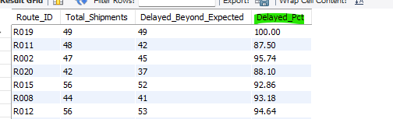
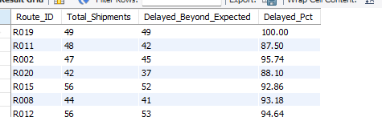
Task 3: Route Optimization Insights
Point 5 Query Used:
3. Calculate delay percentage per route=Delayed_Beyond_Expected / Total_Shipments) * 100
SELECT Route_ID,Total_Shipments,Delayed_Beyond_Expected,ROUND((Delayed_Beyond_Expected * 100.0 / Total_Shipments), 2) AS Delayed_PctFROM (SELECT s.Route_ID,COUNT(*) AS Total_Shipments,SUM(CASEWHEN TIMESTAMPDIFF(HOUR, s.Pickup_Date, s.Delivery_Date) > r.Avg_Transit_Time_HoursTHEN 1 ELSE 0END) AS Delayed_Beyond_ExpectedFROM fedex_shipments sJOIN fedex_routes rON s.Route_ID = r.Route_IDGROUP BY s.Route_ID) AS route_delay;
4. Filter where delay percentage > 20%
SELECT * FROM (SELECT s.Route_ID,COUNT(*) AS Total_Shipments,SUM(CASEWHEN TIMESTAMPDIFF(HOUR, s.Pickup_Date, s.Delivery_Date) > r.Avg_Transit_Time_HoursTHEN 1 ELSE 0END)
AS Delayed_Beyond_Expected,ROUND((SUM(CASEWHEN TIMESTAMPDIFF(HOUR, s.Pickup_Date, s.Delivery_Date) > r.Avg_Transit_Time_HoursTHEN 1 ELSE 0END) * 100.0 / COUNT(*)), 2) AS Delayed_PctFROM fedex_shipments sJOIN fedex_routes rON s.Route_ID = r.Route_IDGROUP BY s.Route_ID) AS delay_summaryWHERE Delayed_Pct > 20;

Slide 16
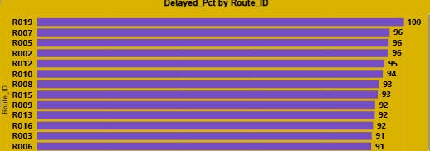
Task 3: Route Optimization Insights
Point 6 Recommended Routes for Optimization
R003 (Singapore -Hong Kong)-Worst efficiency
R019 (Johannesburg -Dubai)-100% delayed shipments
R002 (Dubai → Shanghai)-Extremely high avg delay (41 hours)
Major issues include high transit delays and poor distance efficiency.
Business Recommendations
Re-evaluate carrier partners for R003, R019, R002 and need optimization focus.
Improve coordination at transfer hubs (Hong Kong, Istanbul)
Consider changing flight schedules or transshipment planning
Evaluate alternative hub routing paths and
Try hub-to-hub reroutes like:
Singapore -Tokyo - Hong Kong instead of direct (for R003)
Dubai - Mumbai →-Shanghai instead of direct (for R002)

Slide 17
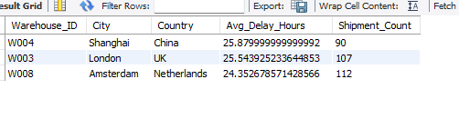
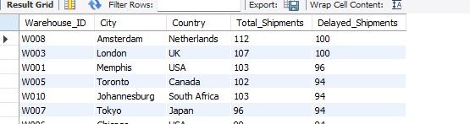
Task 4: Warehouse Performance
Point 1 Query Used
Top 3 warehouses with highest average delay
SELECT s.Warehouse_ID,w.City,w.Country,AVG(s.Delay_Hours) AS Avg_Delay_Hours,COUNT(*) AS Shipment_CountFROM fedex_shipments sJOIN fedex_warehouses wON s.Warehouse_ID = w.Warehouse_IDGROUP BY s.Warehouse_ID, w.City, w.CountryORDER BY Avg_Delay_Hours DESCLIMIT 3;
Point 2 Query Used
Total shipments vs delayed shipments per warehouse
SELECT s.Warehouse_ID,w.City,w.Country,COUNT(*) AS Total_Shipments,SUM(CASE WHEN s.Delay_Hours > 0 THEN 1 ELSE 0 END) AS Delayed_ShipmentsFROM fedex_shipments sJOIN fedex_warehouses wON s.Warehouse_ID = w.Warehouse_IDGROUP BY s.Warehouse_ID, w.City, w.CountryORDER BY Delayed_Shipments DESC;

Slide 18

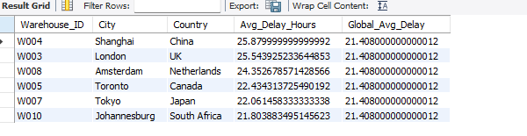
Task 4: Warehouse Performance
Point 3 Query Used
Use CTEs to find warehouses where avg delay > global avg delay
Global average delay (all shipments)
SELECT AVG(Delay_Hours) AS Global_Avg_DelayFROM fedex_shipments;
WITH warehouse_delay AS (SELECT Warehouse_ID,AVG(Delay_Hours) AS Avg_Delay_Hours,COUNT(*) AS Shipment_CountFROM fedex_shipmentsGROUP BY Warehouse_ID),global_delay AS (SELECT AVG(Delay_Hours) AS Global_Avg_DelayFROM fedex_shipments)
SELECT wd.Warehouse_ID,w.City,w.Country,wd.Avg_Delay_Hours,gd.Global_Avg_DelayFROM warehouse_delay wdCROSS JOIN global_delay gdJOIN fedex_warehouses w ON wd.Warehouse_ID = w.Warehouse_IDWHERE wd.Avg_Delay_Hours > gd.Global_Avg_DelayORDER BY wd.Avg_Delay_Hours DESC;

Slide 19
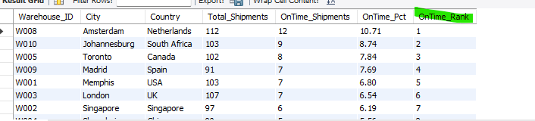
Task 4: Warehouse Performance
Point 4 Query Used
Rank warehouses by on-time delivery percentage
WITH wh_summary AS (SELECT Warehouse_ID,COUNT(*) AS Total_Shipments,SUM(CASE WHEN Delay_Hours <= 0 THEN 1 ELSE 0 END) AS OnTime_ShipmentsFROM fedex_shipmentsGROUP BY Warehouse_ID),wh_rate AS (SELECT ws.Warehouse_ID,w.City,w.Country,ws.Total_Shipments,ws.OnTime_Shipments,ROUND(ws.OnTime_Shipments * 100.0 / ws.Total_Shipments, 2) AS OnTime_PctFROM wh_summary wsJOIN fedex_warehouses wON ws.Warehouse_ID = w.Warehouse_ID)SELECT Warehouse_ID,City,Country,Total_Shipments,OnTime_Shipments,OnTime_Pct,RANK() OVER (ORDER BY OnTime_Pct DESC) AS OnTime_RankFROM wh_rateORDER BY OnTime_Rank;

Slide 20
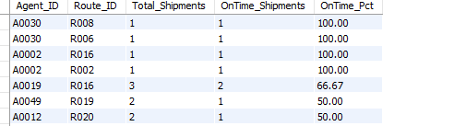
Task 5: Delivery Agent Performance
Point 1 Query Used
Rank delivery agents (per route) by on-time delivery %
Each agent’s performance on each route
WITH agent_route_perf AS (SELECT s.Agent_ID,s.Route_ID,COUNT(*) AS Total_Shipments,SUM(CASE WHEN s.Delay_Hours <= 0 THEN 1 ELSE 0 END) AS OnTime_ShipmentsFROM fedex_shipments s
GROUP BY s.Agent_ID, s.Route_ID)SELECT Agent_ID,Route_ID,Total_Shipments,OnTime_Shipments,ROUND(OnTime_Shipments * 100.0 / Total_Shipments, 2) AS OnTime_PctFROM agent_route_perf;
Ranking within each route
WITH agent_route_perf AS (SELECT s.Agent_ID,s.Route_ID,COUNT(*) AS Total_Shipments,SUM(CASE WHEN s.Delay_Hours <= 0 THEN 1 ELSE 0 END) AS OnTime_ShipmentsFROM fedex_shipments sGROUP BY s.Agent_ID, s.Route_ID),agent_route_ranked AS (SELECT Agent_ID,Route_ID,Total_Shipments,OnTime_Shipments,ROUND(OnTime_Shipments * 100.0 / Total_Shipments, 2) AS OnTime_Pct,RANK() OVER (PARTITION BY Route_IDORDER BY OnTime_Shipments * 1.0 / Total_Shipments DESC) AS OnTime_Rank_In_RouteFROM agent_route_perf)SELECT * FROM agent_route_rankedORDER BY Route_ID, OnTime_Rank_In_Route;

Slide 21
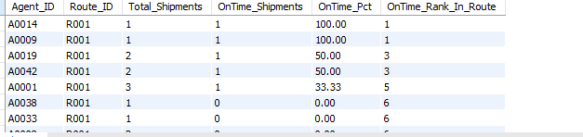
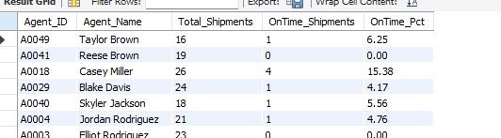
Task 5: Delivery Agent Performance
Point 1 Query Used
Point 2 Query Used
Find agents whose on-time % is below 85%
WITH agent_overall_perf AS (SELECT Agent_ID,COUNT(*) AS Total_Shipments,SUM(CASE WHEN Delay_Hours <= 0 THEN 1 ELSE 0 END) AS OnTime_ShipmentsFROM fedex_shipmentsGROUP BY Agent_ID)SELECT aop.Agent_ID,da.Agent_Name,aop.Total_Shipments,aop.OnTime_Shipments,ROUND(aop.OnTime_Shipments * 100.0 / aop.Total_Shipments, 2) AS OnTime_PctFROM agent_overall_perf aopJOIN fedex_delivery_agents daON aop.Agent_ID = da.Agent_ID;

Slide 22
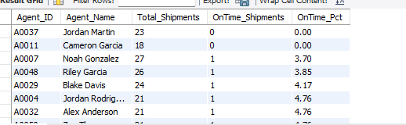
Task 5: Delivery Agent Performance
Point 2 Query Used
Filter on-time % < 85%
WITH agent_overall_perf AS (SELECT Agent_ID,COUNT(*) AS Total_Shipments,SUM(CASE WHEN Delay_Hours <= 0 THEN 1 ELSE 0 END) AS OnTime_ShipmentsFROM fedex_shipmentsGROUP BY Agent_ID)SELECT aop.Agent_ID,da.Agent_Name,aop.Total_Shipments,aop.OnTime_Shipments,ROUND(aop.OnTime_Shipments * 100.0 / aop.Total_Shipments, 2) AS OnTime_PctFROM agent_overall_perf aopJOIN fedex_delivery_agents daON aop.Agent_ID = da.Agent_IDWHERE (aop.OnTime_Shipments * 100.0 / aop.Total_Shipments) < 85ORDER BY OnTime_Pct;
Point 3 Query Used
Compare avg rating & experience of top 5 vs bottom 5 agents (using subqueries)
WITH agent_perf AS (SELECT da.Agent_ID,da.Agent_Name,da.Experience_Years,da.Avg_Rating,COUNT(*) AS Total_Shipments,SUM(CASE WHEN s.Delay_Hours <= 0 THEN 1 ELSE 0 END) AS OnTime_Shipments,ROUND(SUM(CASE WHEN s.Delay_Hours <= 0 THEN 1 ELSE 0 END) * 100.0 / COUNT(*), 2) AS OnTime_PctFROM fedex_delivery_agents daJOIN fedex_shipments sON da.Agent_ID = s.Agent_IDGROUP BY da.Agent_ID, da.Agent_Name, da.Experience_Years, da.Avg_Rating)SELECT * FROM agent_perf;

Slide 23
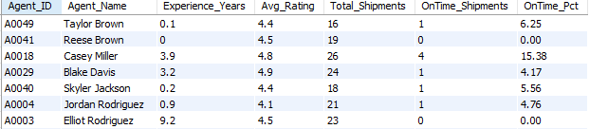
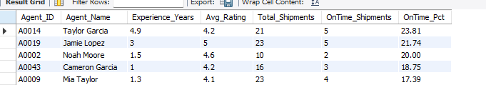
Task 5: Delivery Agent Performance
Top 5 agents by on-time %
WITH agent_perf AS (SELECT da.Agent_ID,da.Agent_Name,da.Experience_Years,da.Avg_Rating,COUNT(*) AS Total_Shipments,SUM(CASE WHEN s.Delay_Hours <= 0 THEN 1 ELSE 0 END) AS OnTime_Shipments,ROUND((SUM(CASE WHEN s.Delay_Hours <= 0 THEN 1 ELSE 0 END) * 100.0 / COUNT(*)), 2) AS OnTime_PctFROM fedex_delivery_agents daJOIN fedex_shipments sON da.Agent_ID = s.Agent_IDGROUP BY da.Agent_ID, da.Agent_Name, da.Experience_Years, da.Avg_Rating)SELECT * FROM agent_perfORDER BY OnTime_Pct DESC -- Top 5 firstLIMIT 5;

Slide 24
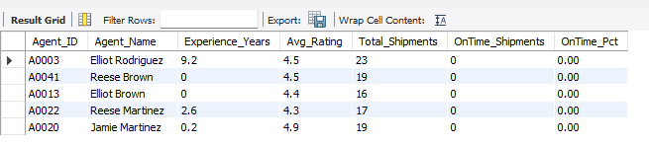
Task 5: Delivery Agent Performance
Bottom 5 agents by on-time %
WITH agent_perf AS (SELECT da.Agent_ID,da.Agent_Name,da.Experience_Years,da.Avg_Rating,COUNT(*) AS Total_Shipments,SUM(CASE WHEN s.Delay_Hours <= 0 THEN 1 ELSE 0 END) AS OnTime_Shipments,ROUND((SUM(CASE WHEN s.Delay_Hours <= 0 THEN 1 ELSE 0 END) * 100.0 / COUNT(*)), 2) AS OnTime_PctFROM fedex_delivery_agents daJOIN fedex_shipments sON da.Agent_ID = s.Agent_IDGROUP BY da.Agent_ID, da.Agent_Name, da.Experience_Years, da.Avg_Rating)SELECT * FROM agent_perfORDER BY OnTime_Pct ASC -- Worst firstLIMIT 5;

Slide 25
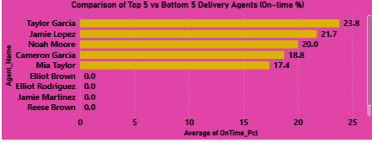
Task 5: Delivery Agent Performance
Point 4:
Insights:
Majority of low-performing agents have 0–1 year experience and 0% on-time deliveries.
2. Top 5 agents have higher experience (1.5–5 years) and better ratings.
Recommendations
Targeted Training Programs for Bottom 5 Agents.
Assign top-performing agents as mentors to the lowest performing ones.
Workload Rebalancing Based on Performance.
Implement Performance-Based Incentives.
Improve Tracking and Support Tools.
Reassign shipments based on performance ranking

Slide 26
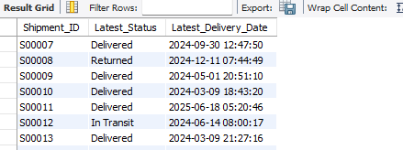
Task 6: Shipment Tracking Analytics
Point 1 Query Used:
Latest status & latest Delivery_Date for each shipment:
WITH shipment_latest AS (SELECT Shipment_ID,Delivery_Status,Delivery_Date,ROW_NUMBER() OVER (PARTITION BY Shipment_IDORDER BY Delivery_Date DESC) AS rnFROM fedex_shipments)SELECT Shipment_ID,Delivery_Status AS Latest_Status,Delivery_Date AS Latest_Delivery_DateFROM shipment_latestWHERE rn = 1;
Point 2 Query Used:
Routes where majority shipments are still “In Transit” or “Returned” and routes where > 50% of shipments are not yet delivered.
WITH route_status AS (SELECT Route_ID,COUNT(*) AS Total_Shipments,SUM(CASE WHEN Delivery_Status IN ('In Transit', 'Returned') THEN 1 ELSE 0END) AS Not_Completed_ShipmentsFROM fedex_shipmentsGROUP BY Route_ID)SELECT Route_ID,Total_Shipments,Not_Completed_Shipments,ROUND(Not_Completed_Shipments * 100.0 / Total_Shipments, 2) AS Not_Completed_PctFROM route_statusWHERE Not_Completed_Shipments * 1.0 / Total_Shipments > 0.5 -- majorityORDER BY Not_Completed_Pct DESC;

Slide 27

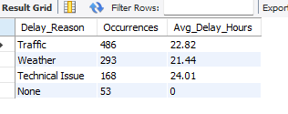
Task 6: Shipment Tracking Analytics
Point 2:
Point 3 Query Used:
Most frequent delay reasons:
SELECT Delay_Reason,COUNT(*) AS Occurrences,ROUND(AVG(Delay_Hours), 2) AS Avg_Delay_HoursFROM fedex_shipmentsWHERE Delay_Reason IS NOT NULLGROUP BY Delay_ReasonORDER BY Occurrences DESC;
Point 4 Query Used:
Orders with exceptionally high delay (>120 hours)
SELECT s.Shipment_ID,s.Order_ID,s.Route_ID,s.Warehouse_ID,s.Agent_ID,s.Delay_Hours,s.Pickup_Date,s.Delivery_Date,s.Delivery_Status,s.Delay_ReasonFROM fedex_shipments sWHERE s.Delay_Hours > 120ORDER BY s.Delay_Hours DESC;

Slide 28
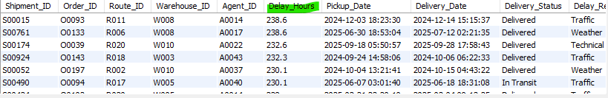
Task 6: Shipment Tracking Analytics
Point 4:

Slide 29
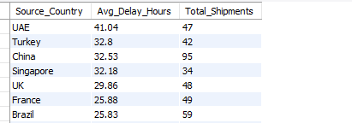

Task 7: Advanced KPI Reporting
Point 1 Query Used:
KPI – Average Delivery Delay per Source_Country
SELECT r.Source_Country,ROUND(AVG(s.Delay_Hours), 2) AS Avg_Delay_Hours,COUNT(*) AS Total_ShipmentsFROM fedex_shipments sJOIN fedex_routes rON s.Route_ID = r.Route_IDGROUP BY r.Source_CountryORDER BY Avg_Delay_Hours DESC;
Point 2 Query Used:
KPI – On-Time Delivery %=(Total On-Time Deliveries / Total Deliveries) * 100
Overall On-Time %

Slide 30
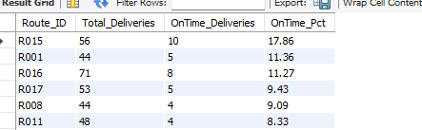
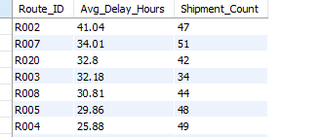
Task 7: Advanced KPI Reporting
Point 2 :
On-Time % per Route_ID
SELECT Route_ID,COUNT(*) AS Total_Deliveries,SUM(CASE WHEN Delay_Hours <= 0 THEN 1 ELSE 0 END) AS OnTime_Deliveries,ROUND(SUM(CASE WHEN Delay_Hours <= 0 THEN 1 ELSE 0 END) * 100.0 / COUNT(*),2) AS OnTime_PctFROM fedex_shipmentsGROUP BY Route_IDORDER BY OnTime_Pct DESC;
Point 3 Query Used:
Average Delay (in hours) per Route_ID
SELECT Route_ID,ROUND(AVG(Delay_Hours), 2) AS Avg_Delay_Hours,COUNT(*) AS Shipment_CountFROM fedex_shipmentsGROUP BY Route_IDORDER BY Avg_Delay_Hours DESC;

Slide 31
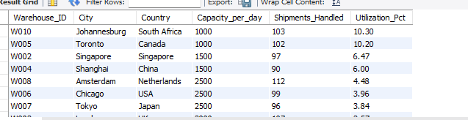
Task 7: Advanced KPI Reporting
Point 4 :
KPI – Warehouse Utilization %=(Shipments_Handled / Capacity_per_day) * 100
SELECT w.Warehouse_ID,w.City,w.Country,w.Capacity_per_day,COUNT(s.Shipment_ID) AS Shipments_Handled,ROUND(COUNT(s.Shipment_ID) * 100.0 / w.Capacity_per_day,2) AS Utilization_PctFROM fedex_warehouses wLEFT JOIN fedex_shipments s ON w.Warehouse_ID = s.Warehouse_IDGROUP BY w.Warehouse_ID, w.City, w.Country, w.Capacity_per_dayORDER BY Utilization_Pct DESC;

Slide 32

Final Summary: key insights and Business Recommendations
Key Insights Summary:
Some routes show very high transit delays and poor efficiency (R003 Singapore–Hong Kong, R019 Johannesburg–Dubai, R002 Dubai–Shanghai)
Multiple routes have >20% shipments delayed beyond expected transit time, signaling scheduling or operational issues.
Top 3 warehouses show the highest average delay, indicating bottlenecks in handling capacity or process flows.
Top 5 agents have significantly higher experience (2–5 years) and strong ratings.
Bottom 5 agents have very low experience (0–1 years) and near-zero on-time delivery performance.
Delay reasons like Traffic, Weather, and Technical issues have the highest frequency.
On-Time Delivery % varies widely among routes and warehouses.
Some shipments remain In Transit or Returned, especially clustered across specific routes.

Slide 33
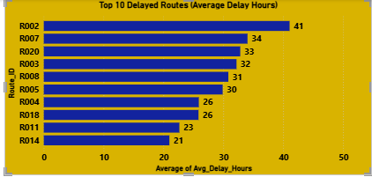
Final Summary: key insights and Business Recommendations
Business Recommendations:
Reroute critical paths (e.g., Singapore–Tokyo–Hong Kong, Dubai–Mumbai–Shanghai).
Add predictive scheduling using historic delay patterns.
Introduce real-time monitoring of inbound/outbound traffic.
Increase automation and labor capacity where delays persist.
Implement structured training programs targeted at bottom 5 performers.
Pair low-performing agents with top agents for field mentoring.
Provide estimated real-time tracking for high-delay routes.

Slide 34
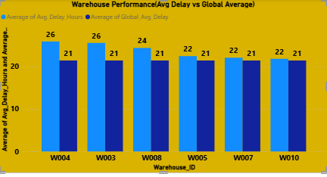
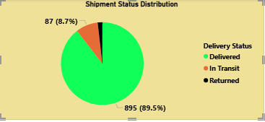
Final Summary: key insights and Business Recommendations

